Slide 1


Slide 2
Problem Scenario for Ferozsons Pharmaceuticals – Portfolio Project Overview
Project Overview:
Ferozsons Pharmaceuticals, a leading pharmaceutical company, is facing significant challenges in managing its inventory, orders, and supplier relationships due to inefficiencies in its internal database system. The database, which was designed to streamline operations and improve decision-making, has exposed gaps in real-time data accuracy and process coordination. These issues are now impacting the company’s ability to meet customer demands, fulfill orders on time, and efficiently manage product restocking from suppliers.
Key Challenges:
1. Inventory Management: The current system lacks real-time updates to the inventory, resulting in stockouts and unfulfilled orders. Products marked as "available" in the database are often found to be out of stock during order processing, leading to customer dissatisfaction.
2. Order Processing Delays: Due to incomplete and outdated information in the orders and order details tables, the company is experiencing frequent delays in order fulfillment. This is compounded by payment processing issues, causing further delays in shipping and customer service.
3. Supplier and Restocking Inefficiencies: Outdated supplier data makes it difficult for the procurement department to maintain consistent stock levels. In addition, a lack of integration between new product data and suppliers is causing delays in restocking critical products.
4. Interdepartmental Coordination: Departments responsible for sales, procurement, and warehouse operations lack proper coordination. As a result, there is confusion around prioritizing orders and maintaining accurate stock records.
Project Outcome: In this portfolio project, the Ferozsons Pharmaceuticals database was designed and implemented using SQL Server to simulate a real-world enterprise resource planning (ERP) scenario. The project focused on creating a comprehensive database structure, including tables for customers, employees, products, orders, inventory, payments, suppliers, and more. The key objective was to provide a solution that could be scaled for better management of the company’s internal operations, specifically improving order accuracy, inventory tracking, and supplier coordination.
This database implementation and analysis demonstrate an understanding of data management challenges in a business setting and provide practical solutions for streamlining operations, which are essential skills for any data specialist role.

Slide 3
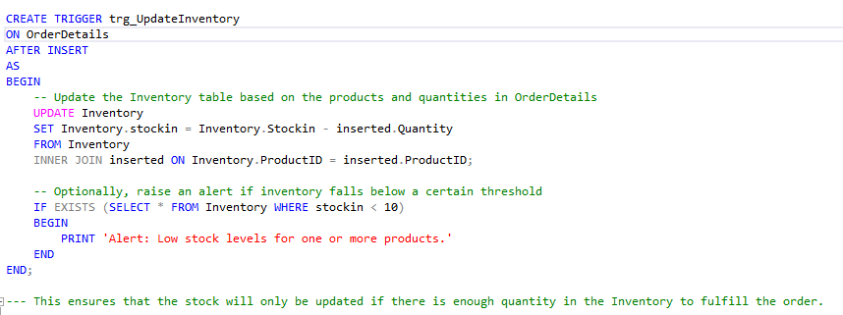
1. Issue: Inaccurate Inventory Records
Solution:
Update inventory levels in real-time whenever new orders are placed. We can create a trigger to update the Inventory table when an order is placed, ensuring the stock quantity is reduced based on the order. SQL Trigger to Automatically Update Inventory on New Orders:
This ensures that the stock will only be updated if there is enough quantity in the Inventory to fulfill the order.

Slide 4
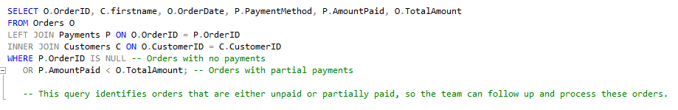
2. Issue: Order Processing Delays
Solution:
Create a report to identify orders stuck in processing or unpaid orders.
We can create a query to fetch orders where payment is either pending or incomplete, so the order processing team can take action.
This query identifies orders that are either unpaid or partially paid, so the team can follow up and process these orders.

Slide 5
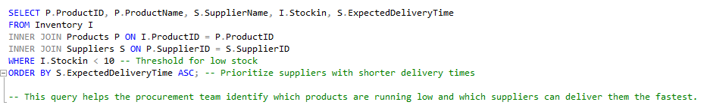
3. Issue: Supplier and Restocking Inefficiencies
Solution:
Solution: Prioritize suppliers based on delivery times and update stock with incoming supplies.
We can create a query that checks which products are running low on stock and identifies the suppliers that can restock these items quickly.
SQL Query to Identify Low-Stock Products and Suppliers:
This query helps the procurement team identify which products are running low and which suppliers can deliver them the fastest.

Slide 6
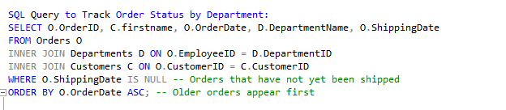
4. Issue: Department Coordination Breakdown
Solution:
Generate a report that highlights pending orders and their associated departments for smoother communication.
We can create a query to track the current status of orders and which departments are responsible for handling each stage.
This query lists pending orders along with the department responsible for handling them, helping improve communication between teams to prioritize these orders

Slide 7
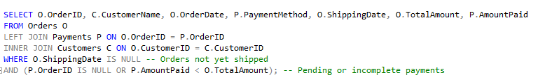
5. Issue: Delayed Payments Impacting Shipping
Solution:
Notify the finance department of any pending payments that are delaying shipping
We can write a query to alert the finance team about pending payments that are holding up the shipping process.
SQL Query to Identify Orders Pending Due to Payment Issues:
This query helps the finance team identify orders that are being held up due to payment delays, allowing them to follow up and resolve the issue to ensure timely shipping.

Slide 8
Conclusion
These SQL queries aim to address the operational inefficiencies at Ferozsons Pharmaceuticals, particularly in inventory management, order processing, supplier coordination, and interdepartmental communication. Implementing these queries can streamline the company's database management processes, resulting in improved performance and customer satisfaction.

